Slide 1

Category Code: C1 (Open Innovation)
Problem Statement Title: EduTrade - Swap Skills, Gain Expertise
Team Name: Caffeine Coder
Institute Name: Vivekanand Education Society’s Institute of Technology

Slide 2

Idea / Approach details (& implemented features)
Problem Statement: Many individuals struggle with limited access to quality education, skills mismatching job market demands, financial constraints, and lack of professional networks, leading to unequal job opportunities.
Solution Overview: EduTrade is an AI-powered platform that bridges the gap between learning and employment. It provides personalized skill assessments, free learning resources, AI-driven job matching, a Skill Swap Marketplace, and instant resume generation to help users secure sustainable careers.
User Roles & Features:
Learner: Skill swap, job applications, study groups, AI recommendations.
Mentor: Skill validation, learning sessions, career guidance
Employer: Job postings, candidate reviews, interviews.

Slide 3
Innovation (Showstopper)
Skill Swap Marketplace
Users exchange skills (e.g., coding for UI/UX) using a time-based token system.
AI or manual matching ensures fair and relevant learning exchanges.
Job Market Integration
AI-driven smart job matching connects users with relevant opportunities.
Includes resume building, interview prep, and direct recruitment.
Instant AI Resume & Portfolio Generator
AI creates professional resumes, cover letters, and project portfolios.
Real-time updates based on new certifications and work experience.
Gamified Skill Challenges & Hackathons
Daily challenges, leaderboards, and digital badges for skill mastery.
Community-driven hackathons to foster engagement and innovation.
Personalized Study Groups & Accountability Buddies
AI matches users with peers and mentors based on learning goals.
Virtual study groups with progress tracking for motivation.
Instant Skill Endorsements from Mentors
Industry experts validate skills based on projects and performance.
Enhances credibility, boosting job and freelancing prospects.

Slide 4
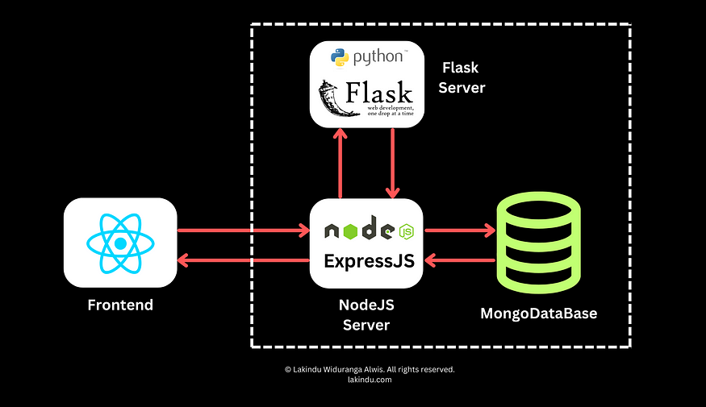
Tech Stack
Frontend: React.js
Backend: Node.js, Flask
Database: MongoDB
Machine Learning: Python

Slide 5
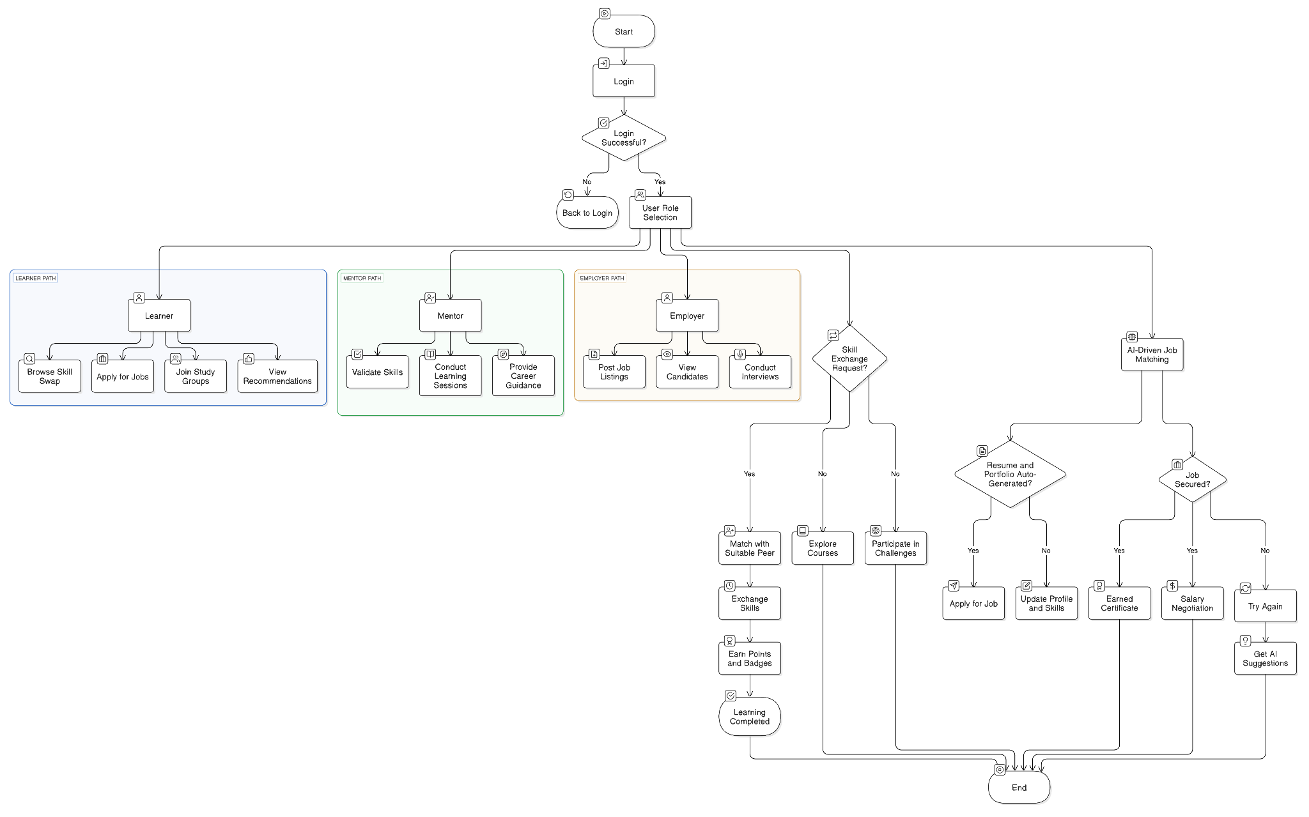
Use Case Diagram

Slide 6
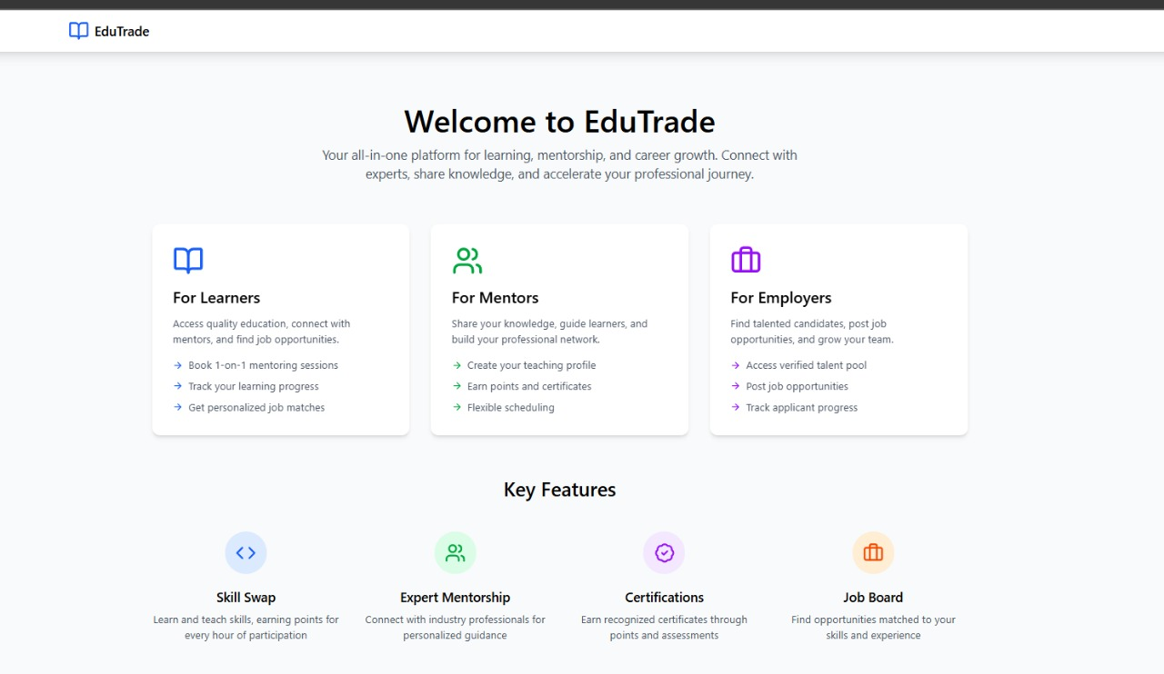
Implementation
Welcome Section – Introduces EduTrade as a platform for learning, mentorship, and career growth.
User Categories – Sections for Learners, Mentors, and Employers with their respective benefits.
Key Features – Highlights Skill Swap, Expert Mentorship, Certifications, and Job Board.
User Engagement – Encourages skill-sharing, learning progress tracking, and job matching.
Modern UI/UX – Clean, responsive design using React.js and Tailwind CSS for easy navigation.
Call to Action – Directs users to sign up and explore the platform’s services.
Landing Page

Slide 7
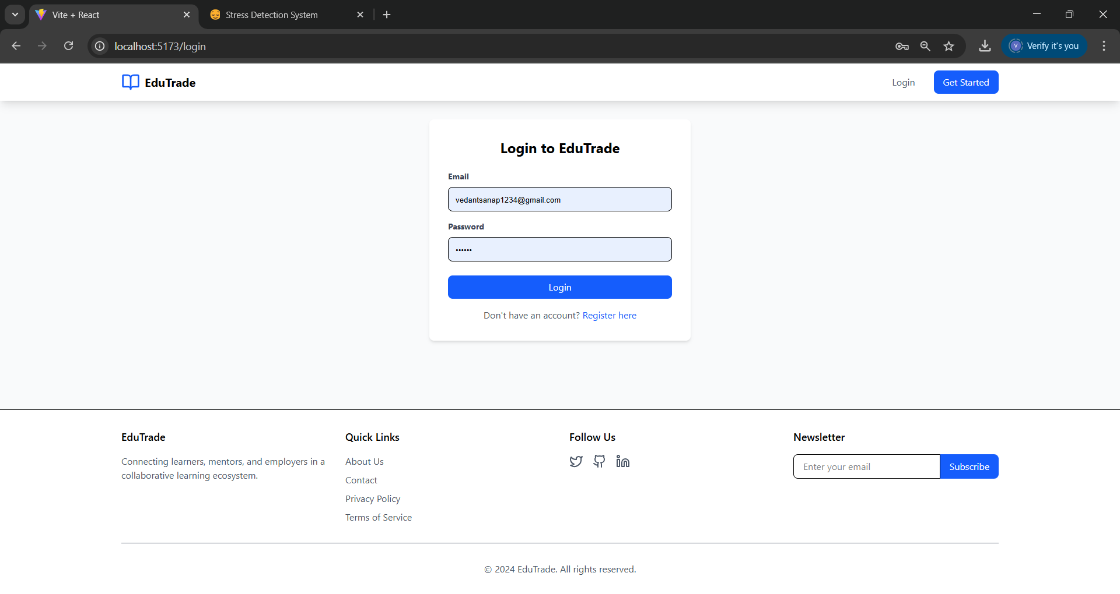
Implementation
Role-Based Authentication – Users log in with unique credentials and access features based on their role (Learner, Mentor, or Employer).
Secure Access Control – Ensures restricted access to role-specific functionalities using authentication keys or tokens.
Learner Dashboard – Provides access to courses, progress tracking, and feedback submission.
Mentor Dashboard – Enables content creation, feedback management, and interaction with learners.
Employer Dashboard – Allows job postings, candidate searches, and engagement with potential hires.
Session Management – Uses JWT or OAuth for secure login sessions and role verification.
Role Based Login

Slide 8
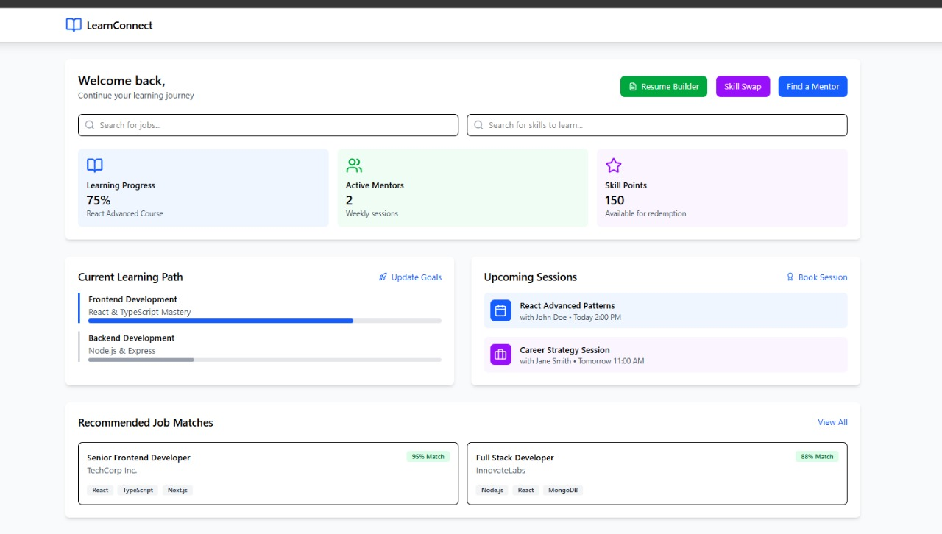
Implementation
Personalized Dashboard – Displays learning progress, mentors, and available skill points.
Search & Navigation – Users can search for jobs or skills to learn efficiently.
Current Learning Path – Tracks progress in frontend and backend development courses.
Upcoming Sessions – Scheduled mentoring sessions with topics and mentors.
Job Recommendations – AI-driven job matches based on skills and progress.
Quick Actions – Buttons for Resume Builder, Skill Swap, and Find a Mentor for career growth.
Learner Dashboard

Slide 9
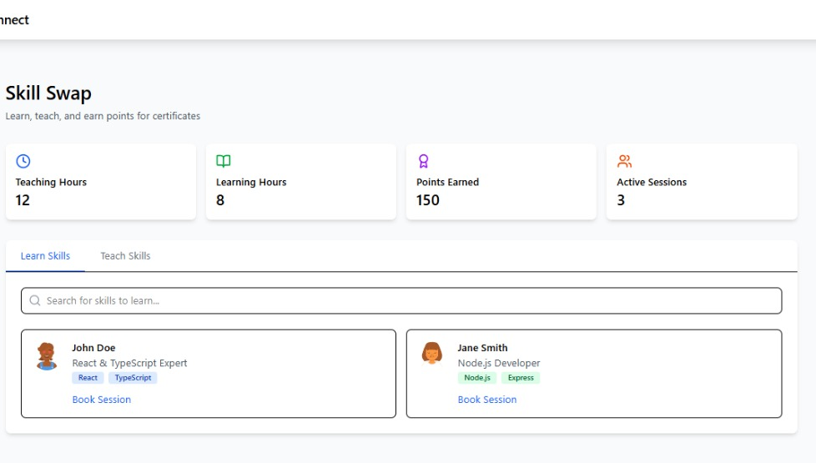
Implementation
Learn & Teach Skills – Users can exchange skills to earn points and certificates.
Performance Tracking – Displays Teaching Hours, Learning Hours, Points Earned, and Active Sessions.
Search & Discover – Users can find experts based on skills like React, TypeScript, Node.js, etc.
Book Sessions – Allows easy scheduling of skill exchange sessions with mentors.
Dual Mode – Users can Learn Skills or Teach Skills to contribute to the community.
Gamification – Encourages participation by rewarding points for teaching and learning.
Skill Swap

Slide 10
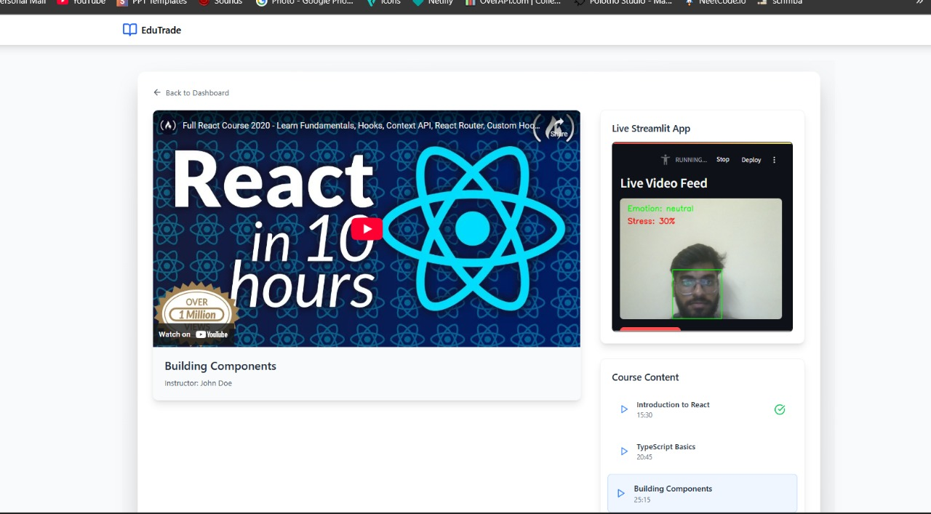
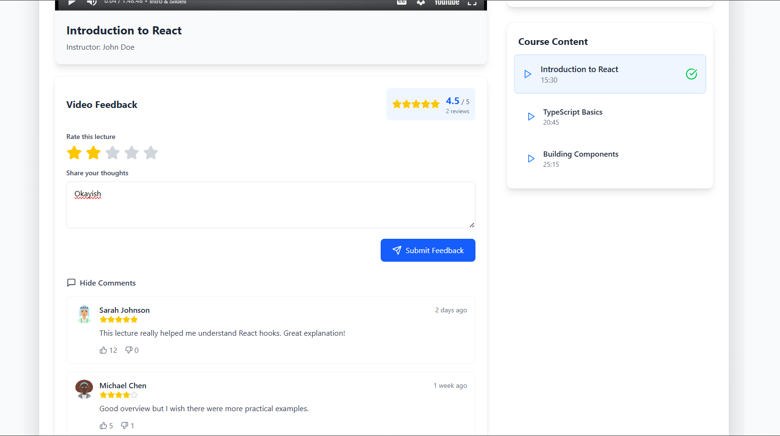
Implementation
Embedded Video Lectures – Users can watch courses directly via an embedded YouTube player.
Live Emotion Analysis – Integrated AI-based emotion detection shows real-time stress levels and emotions.
Course Progress Tracking – Users can see completed and pending lessons in the course content list.
Instructor Information – Displays instructor name and course details for better user engagement.
Structured Course Content – Lessons are categorized with duration (e.g., 15:30 mins for "Introduction to React").
Feedback System – Enables users to rate and review course content.
View Courses

Slide 11
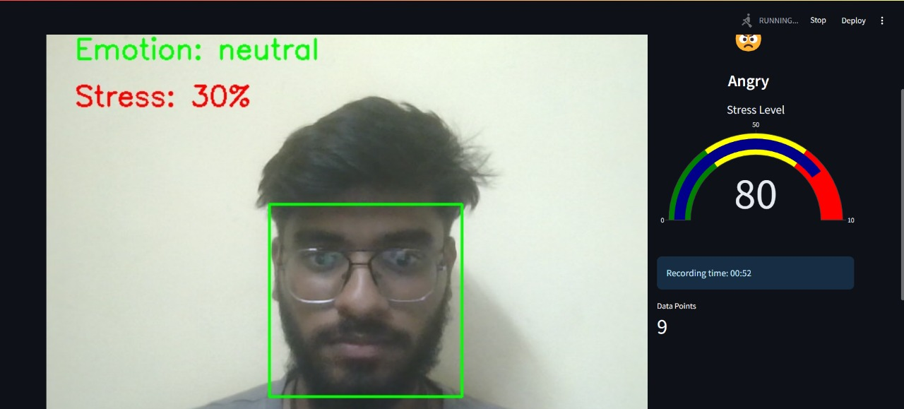
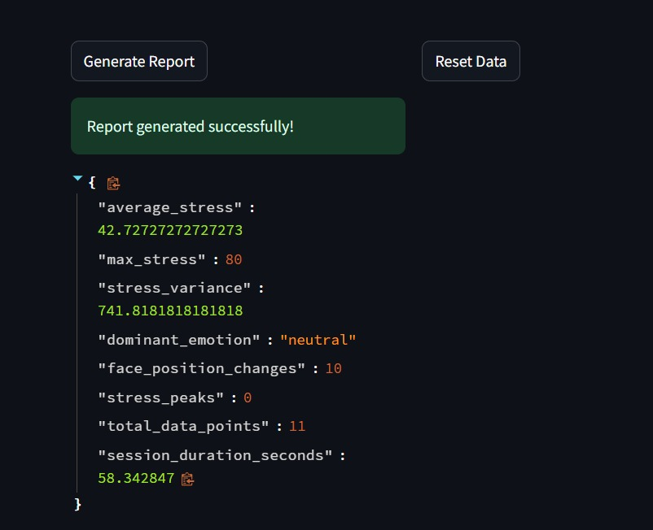
Implementation
Key Features of the Emotion and Stress Tracking System:
Real-Time Emotion & Stress Detection: Captures emotions (neutral, angry, happy, sad) and stress levels on a 0-80% scale, with the dominant emotion recorded as neutral in this session.
Stress & Emotion Visualization: Includes a stress timeline graph, an emotion distribution pie chart, and a heatmap linking facial positions to stress intensity.
Detailed Session Analytics: Provides average stress (46%), maximum stress (80%), stress variance (693.3), and total recording duration (~58 seconds) with 11 data points.
Facial Tracking & Movement Analysis: Tracks face position, detects subtle movements (10 recorded position changes), and uses a green bounding box for face detection.
Correlation Between Emotion & Movement: Analyzes how emotional states relate to physical movement, measuring movement in pixels and linking different emotions to varying activity levels.
Comprehensive Behavioral Insights: Offers a multi-dimensional analysis of stress, emotions, and physical movement for better understanding of psychological responses.

Slide 12
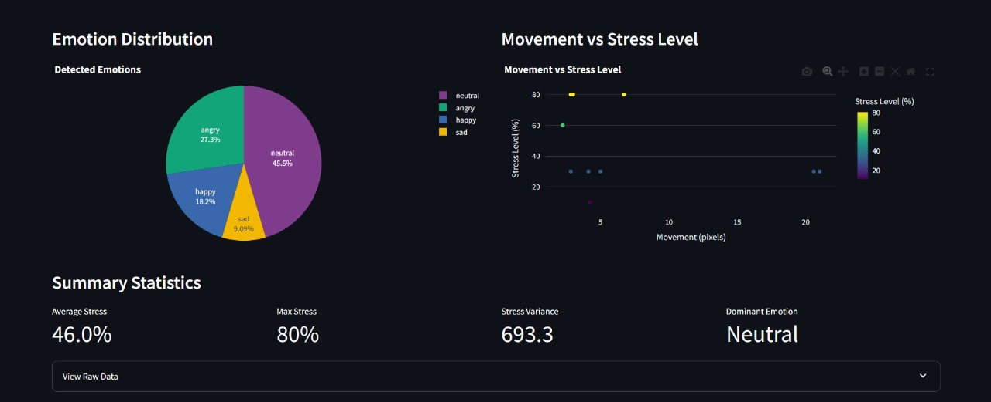
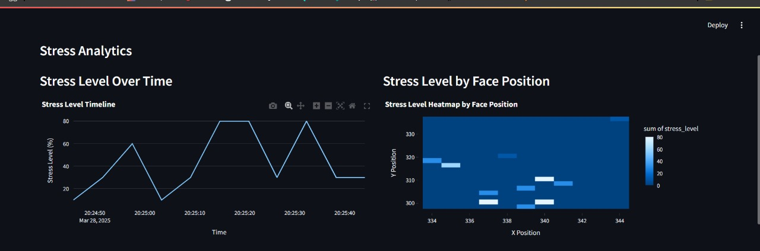
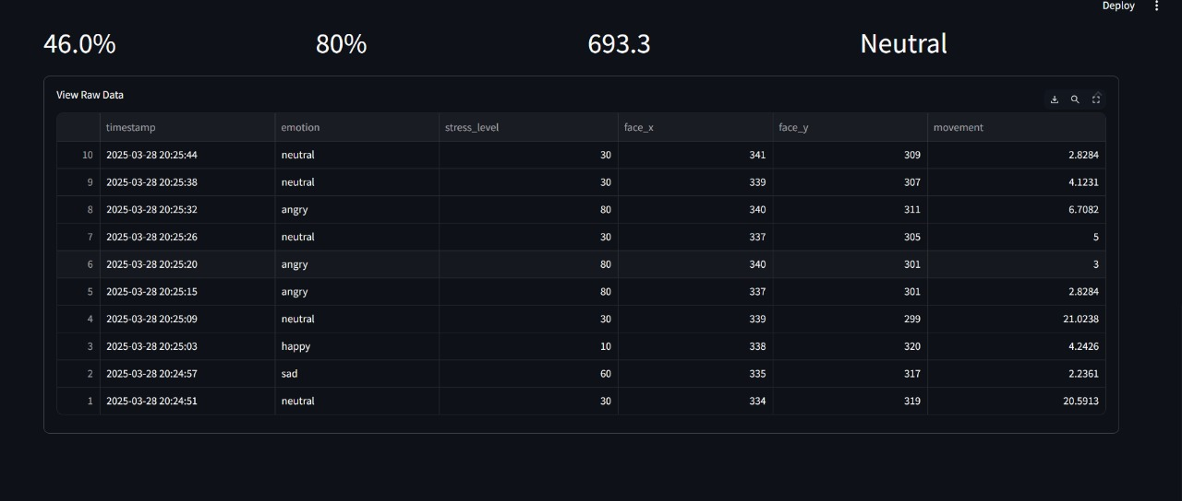
Implementation

Slide 13
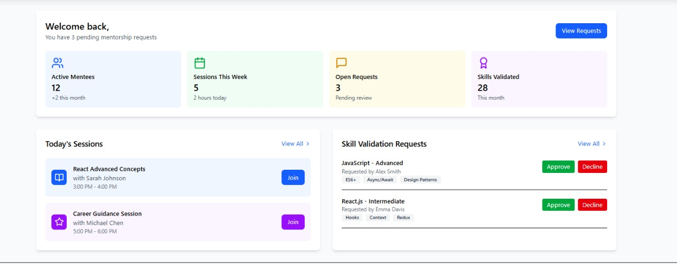
Implementation
Mentee Management – Track and manage active mentees and their progress.
Session Overview – Displays upcoming mentorship sessions with mentees.
Skill Validation – Approve or decline skill validation requests from learners.
Pending Requests – View and manage mentorship and skill validation requests.
Performance Metrics – Shows sessions conducted, open requests, and skills validated.
Quick Actions – Easy access to joining sessions, approving skills, and handling requests.
Mentors Dashboard

Slide 14
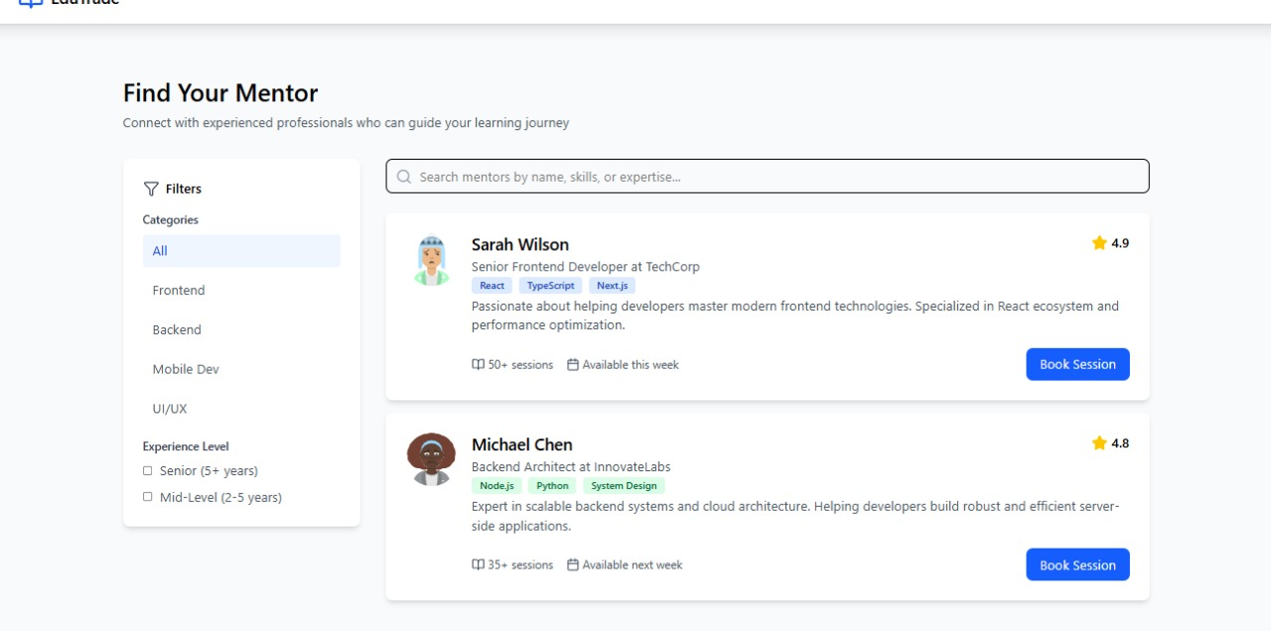
Implementation
Mentor Discovery – Users can search for mentors based on skills, expertise, or name.
Filtering Options – Categories include Frontend, Backend, Mobile Dev, and UI/UX with experience levels.
Mentor Profiles – Displays mentor details like name, role, skills, rating, and availability.
Session Booking – Users can book sessions directly from the mentor’s profile.
User Ratings & Experience – Mentors are rated (⭐4.8, ⭐4.9) based on sessions conducted.
Session Availability – Indicates when a mentor is available for booking.
Finding Mentor

Slide 15
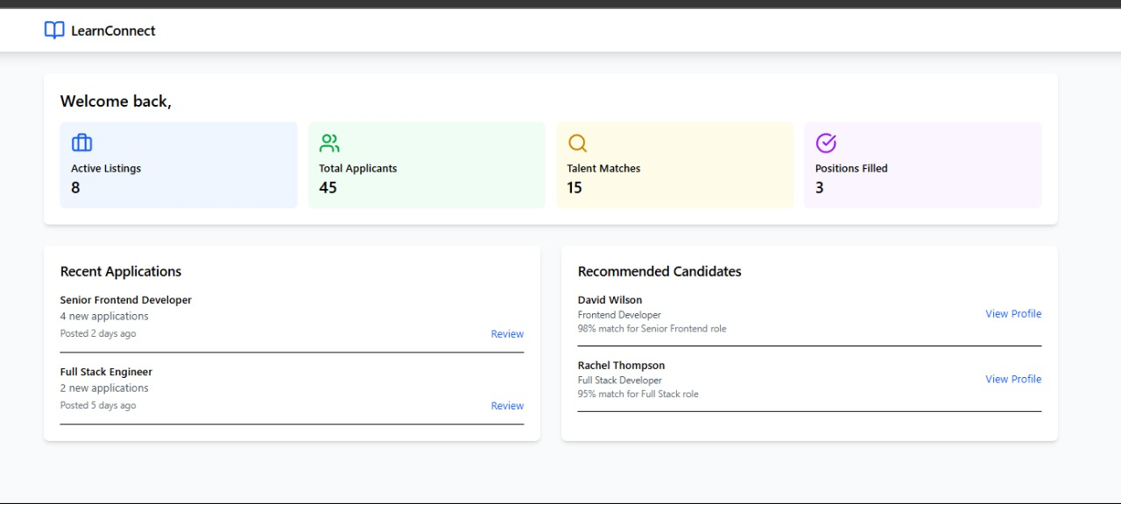
Implementation
Job Listings Overview – Employers can track active job postings and positions filled.
Applicant Tracking – Displays total applicants and talent matches based on job fit.
Recent Applications – Lists newly received applications with job titles, posting dates, and review options.
Candidate Recommendations – Suggests top-matching candidates with match percentage (e.g., 98% match).
Profile Review & Shortlisting – Employers can view candidate profiles and shortlist potential hires.
Hiring Efficiency Insights – Tracks hiring success through key metrics like positions filled and applicant trends.
Employers Dashboard

Slide 16
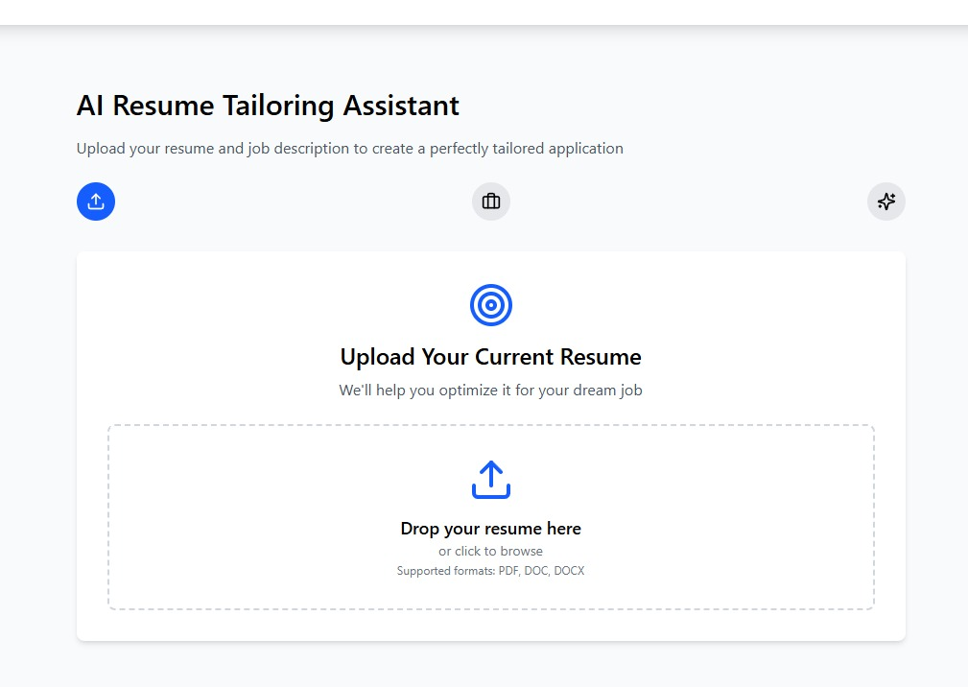
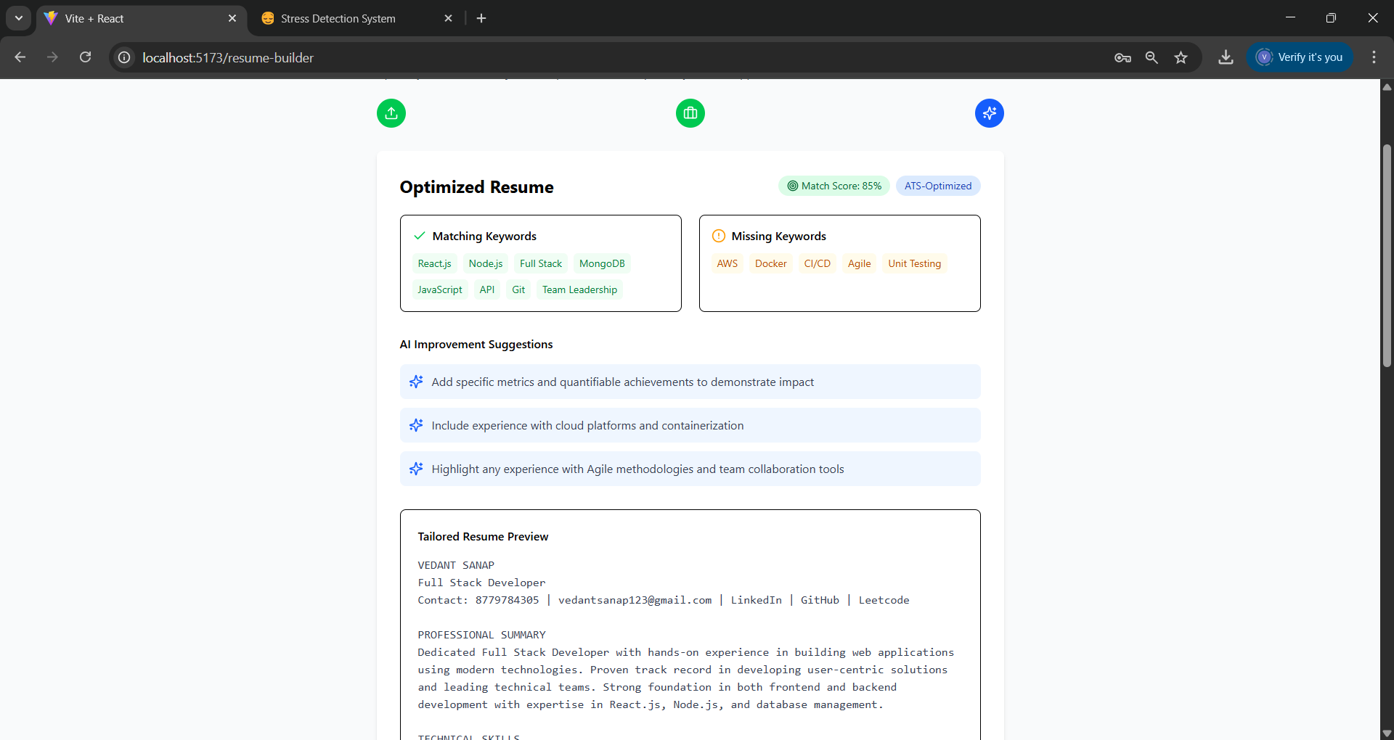
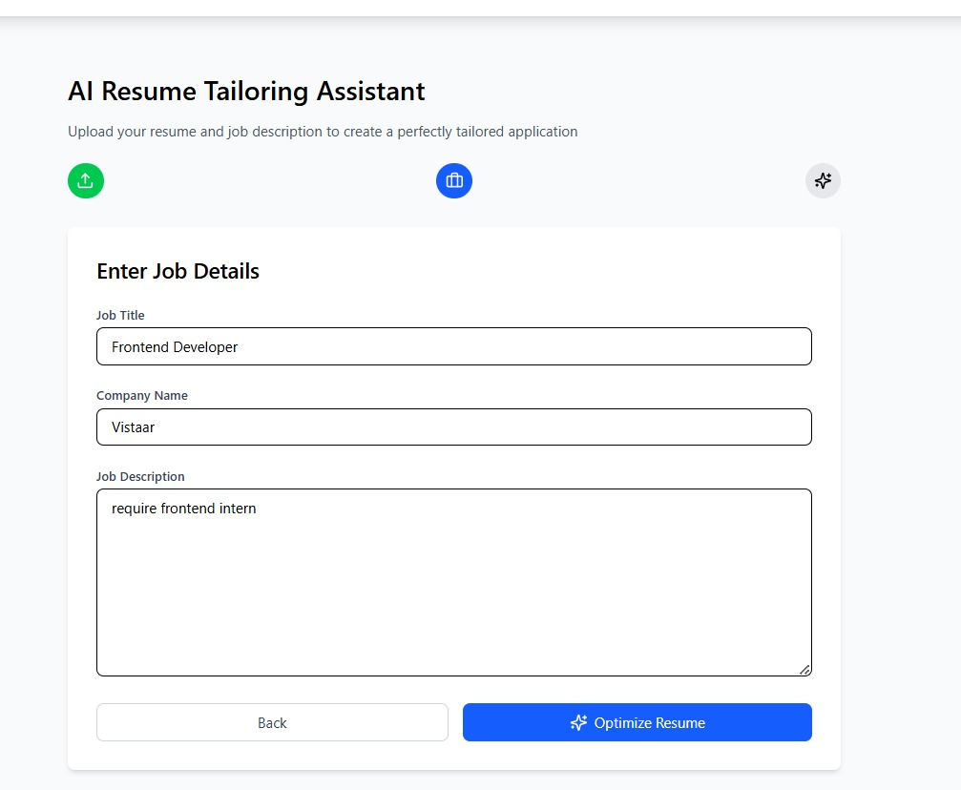
Implementation
Resume Upload & Parsing – Users can upload their resume in PDF, DOC, or DOCX format. The system extracts and analyzes the resume content.
Job Details Input – Users enter job details like title, company name, and job description to tailor the resume accordingly.
Keyword Matching & Score – The system compares the resume against the job description, highlighting matching and missing keywords, and provides a match score.
AI-Powered Improvement Suggestions – The tool suggests enhancements such as emphasizing relevant skills, adding metrics, or highlighting project experiences.
Preview & Edit Option – Users can review the AI-optimized resume content and make edits before finalizing it.
Download Optimized Resume – Once satisfied, users can download the tailored resume, ensuring it aligns well with the job requirements and ATS (Applicant Tracking System) standards.
AI Resume Optimizer

Slide 17
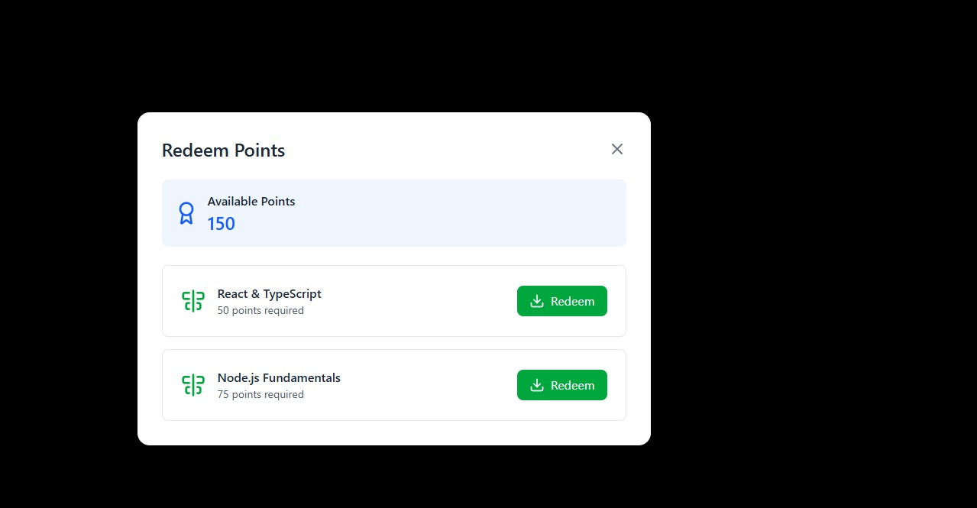
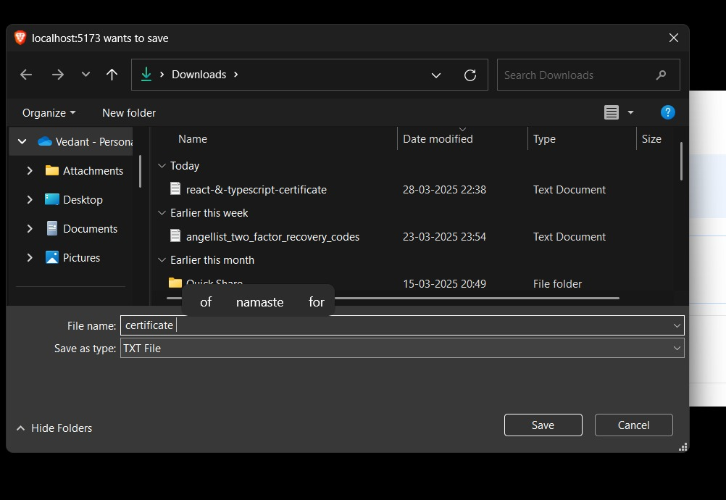
Implementation
Users should only be able to redeem a reward if they have enough points.
After redeeming, the available points should update in real-time.
The "Redeem" button should be disabled if the user lacks sufficient points.
Provide a confirmation prompt before deducting points.
Show a success message and allow users to download their certificate after redemption.
Consider implementing a history section where users can view past redemptions.
Redeem Points

Slide 18
Future Objective
Peer-to-Peer Learning via Video Calls – Enables live skill exchange sessions through secure video calls, fostering interactive learning and mentorship.
Decentralized Learning & Skill Verification – Blockchain-based certificates for verified skill endorsements and decentralized skill records to ensure credibility across platforms.
Metaverse & VR-Based Learning Modules – Immersive learning through VR-based training simulations and virtual skill swap rooms for hands-on experiences.
Smart Contracts for Skill Exchange & Payments – Secure and automated transactions using blockchain to ensure fair exchanges and fraud prevention in freelancing & mentorship.
Automated AI Job & Internship Applications – AI auto-applies to relevant jobs and internships based on user skills, with smart tracking of application status and interview scheduling.

